Slide 1

A Symptom-Based Multi-Disease Prediction System Using Machine Learning
by
C. Eswar
Roll No. 234G5A0502
G. Yashoda Mahitha
Roll No. 224G1A05A2
S. Nikitha
Roll No. 224G1A0561
Under the guidance of
Ms. C. Rekha, M. Tech
Assistant Professor
Department of Computer Science and Engineering
Srinivasa Ramanujan Institute of Technology
Autonomous
Rotarypuram Village, B K Samudram Mandal, Ananthapuramu – 515701.
Accredited by NBA & NAAC with “A” Grade,Affiliated to JNTUA,Ananthapuramu
2025-2026

Slide 2
Title Explaination
A Symptom-Based Multi-Disease Prediction System Using Machine Learning
The title “A Symptom-Based Multi-Disease Prediction System Using Machine Learning” reflects the system’s core functionality, encompassing:
Predicting multiple diseases using patient symptom data.
Detecting diseases such as Diabetes, Heart Attack, Tuberculosis, Pneumonia, Jaundice, and Bronchial Asthma using Machine Learning algorithms.
Applying models including Logistic Regression, Support Vector Machine (SVM), Decision Tree, Random Forest, XGBoost, AdaBoost, and Artificial Neural Networks (ANN).
Enabling fast and accurate symptom-based disease prediction, reducing manual diagnosis effort and supporting early medical decision-making.

Slide 3
Contents
A Symptom-Based Multi-Disease Prediction System Using Machine Learning
Abstract
Introduction
Software Requirements
Datasets/Modules
Implementation
Outputs
Conclusion
References

Slide 4
Abstract
A Symptom-Based Multi-Disease Prediction System Using Machine Learning
Introduction
Accurate and early prediction of diseases using symptom data plays a vital role in supporting timely medical diagnosis and treatment.
Research Gap
Most existing systems focus on predicting a single disease or lack intelligent learning models capable of handling multiple diseases within a unified framework.
Methodology Used
The proposed system applies machine learning and deep learning techniques including Logistic Regression, Support Vector Machine, Decision Tree, Random Forest, XGBoost, AdaBoost, and an Artificial Neural Network (ANN) to classify multiple diseases based on patient symptoms.
Result
Performance evaluation shows that both machine learning models and the ANN achieve high classification accuracy, demonstrating effective learning of symptom–disease relationships.
Conclusion
The multi-disease prediction system successfully integrates traditional machine learning models with deep learning, offering a reliable and scalable approach for automated disease diagnosis.

Slide 5
Introduction
A Symptom-Based Multi-Disease Prediction System Using Machine Learning
Disease diagnosis based on symptoms is often challenging due to overlapping symptoms across different diseases.
Manual diagnosis requires experienced medical professionals and can be time-consuming, especially in resource-limited environments.
Delayed or incorrect diagnosis may lead to improper treatment and increased health risks.
There is a need for an automated system that can analyze patient symptoms and accurately predict multiple diseases.
This project addresses this problem by using machine learning and Artificial Neural Network models to predict diseases efficiently and support early medical decision-making.

Slide 6
Software Requirements
A Symptom-Based Multi-Disease Prediction System Using Machine Learning
Programming Language: Python
Development Environment: Any Python Code Editor
Operating System: Windows / Linux
Libraries & Frameworks:
NumPy
Pandas
Matplotlib
Seaborn
Scikit-learn
XGBoost, AdaBoost
TensorFlow / Keras (for ANN)
Version Control (Optional): Git
Data Handling Tool: CSV dataset

Slide 7
Datasets/Modules
A Symptom-Based Multi-Disease Prediction System Using Machine Learning
The dataset used in this project is a symptom-based medical dataset consisting of patient health records.
Two datasets are used:
Training Dataset for model training
Testing Dataset for model evaluation
Each record represents a patient case described using multiple symptoms.
From the available diseases, six diseases were selected for prediction: Diabetes, Bronchial Asthma, Pneumonia, Jaundice, Tuberculosis, and Heart Attack.
Symptoms are encoded in binary format, where:
1 indicates the presence of a symptom
0 indicates the absence of a symptom
The dataset contains symptom-related features and a target column named “Prognosis”; it represents the corresponding disease label.
The dataset has no missing values after preprocessing.
Label encoding is applied to convert disease names into numerical form for model training.
The dataset is suitable for supervised multi-class disease prediction.

Slide 8
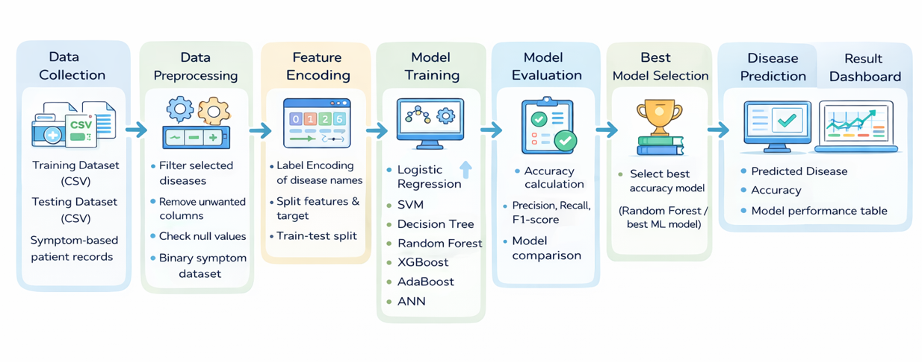
Process Flow
A Symptom-Based Multi-Disease Prediction System Using Machine Learning

Slide 9
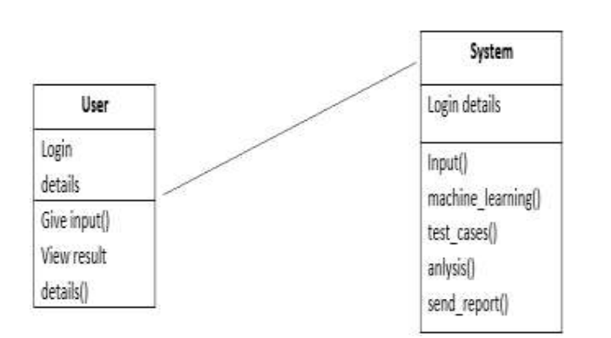
UML Diagram
A Symptom-Based Multi-Disease Prediction System Using Machine Learning
CLASS DIAGRAM

Slide 10
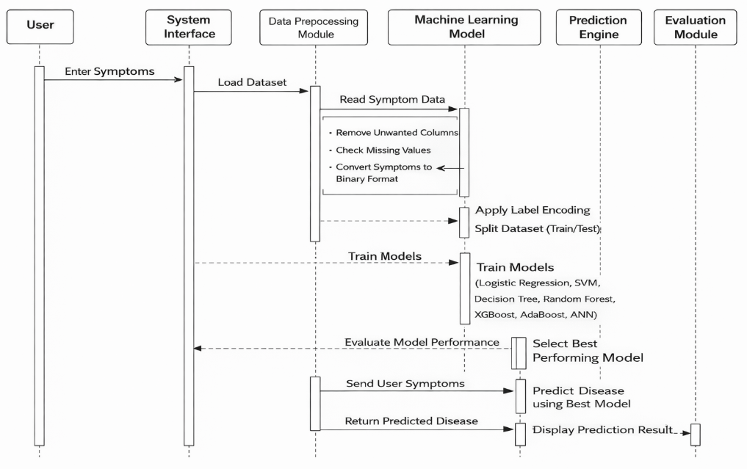
UML Diagram
A Symptom-Based Multi-Disease Prediction System Using Machine Learning
SEQUENCE DIAGRAM

Slide 11
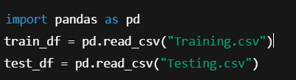
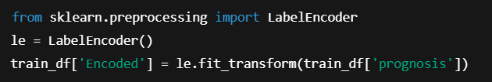
Implementation
A Symptom-Based Multi-Disease Prediction System Using Machine Learning
Data Loading
The dataset is loaded using the Pandas library for easy data manipulation.
Separate files are used for training and testing the models.
This step allows structured access to symptom features and disease labels.
Label Encoding
The disease labels in the prognosis column are categorical in nature.
Label encoding converts disease names into numerical values.
This conversion is required for machine learning and ANN models to process the data.

Slide 12
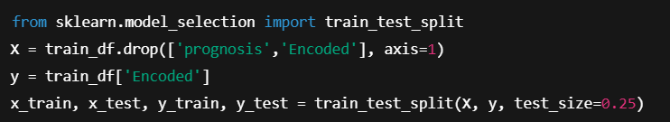
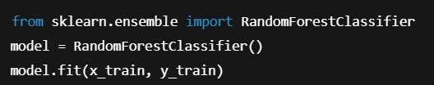
Implementation
A Symptom-Based Multi-Disease Prediction System Using Machine Learning
Train-Test Split
Symptom columns are separated as input features, and encoded disease labels are used as targets.
The dataset is split into training and testing sets.
This helps in evaluating the model’s performance on unseen data.
Machine Learning Model Training
The Random Forest algorithm is used to train the model on symptom data.
It builds multiple decision trees to improve prediction accuracy.
This model helps in learning complex symptom–disease relationships.

Slide 13
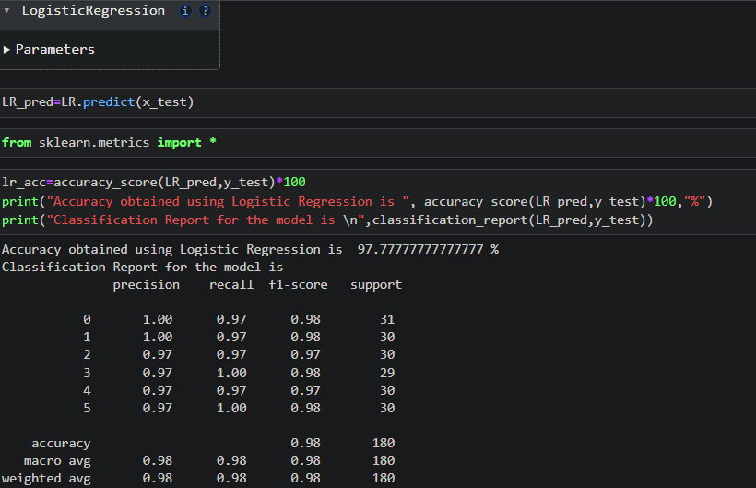
Outputs
A Symptom-Based Multi-Disease Prediction System Using Machine Learning

Slide 14
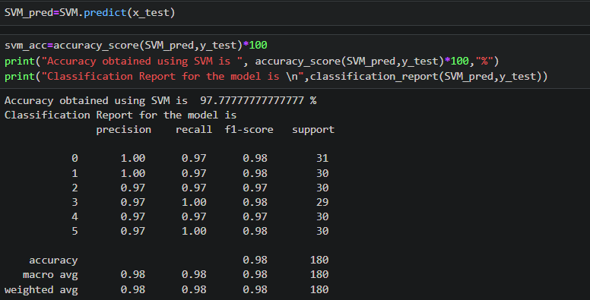
Outputs
A Symptom-Based Multi-Disease Prediction System Using Machine Learning

Slide 15
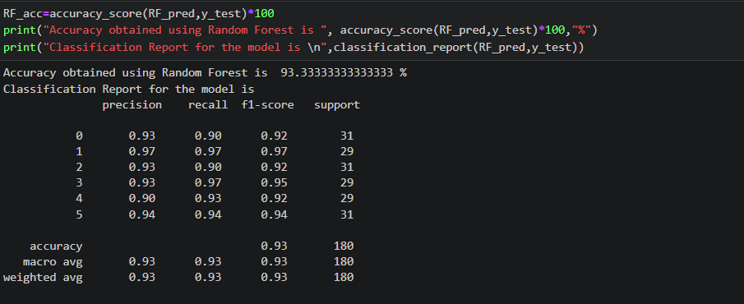
Outputs
A Symptom-Based Multi-Disease Prediction System Using Machine Learning

Slide 16
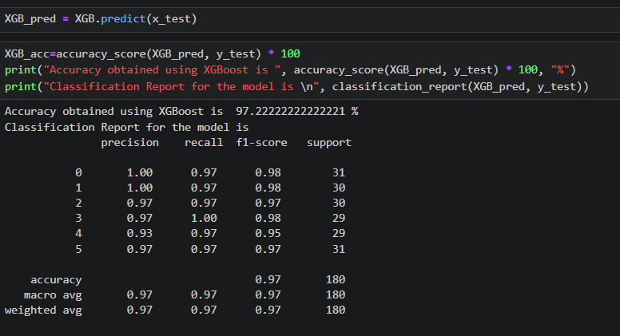
Outputs
A Symptom-Based Multi-Disease Prediction System Using Machine Learning

Slide 17
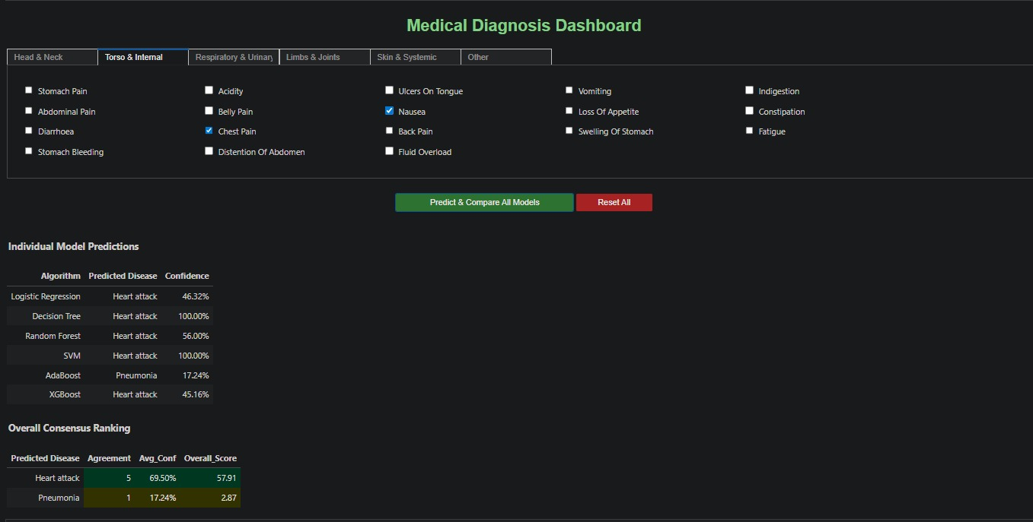
Outputs
A Symptom-Based Multi-Disease Prediction System Using Machine Learning

Slide 18
Conclusion
A Symptom-Based Multi-Disease Prediction System Using Machine Learning
The project developed an AI/ML-based system for predicting multiple diseases using symptom data.
Various machine learning algorithms were implemented to achieve accurate and efficient disease prediction.
The system enables fast and automated diagnosis, reducing dependency on manual analysis.
It provides a cost-effective solution for early detection and supports better medical decision-making.
The project demonstrates the effectiveness of AI/ML in improving healthcare prediction systems.

Slide 19
References
A Symptom-Based Multi-Disease Prediction System Using Machine Learning
[1] H. Liang, B. Y. Tsui, H. Ni, et al., “Evaluation and Accurate Diagnoses of Pediatric Diseases Using Artificial Intelligence,” Journal of Medical Systems, vol. 43, no. 5, pp. 1–12, 2019.
[2] M. J. Shaikh, S. Manjrekar, D. Khan, M. Khan, and D. Jamadar, “Multiple Disease Prediction Webapp,” Journal of Emerging Technologies and Innovative Research (JETIR), vol. 8, no. 6, pp. 1–6, 2021.
[3] R. C. Deo, “Machine Learning in Medicine,” Circulation, vol. 132, no. 20, pp. 1920–1930, 2015.
[4] “Multiple Disease Prediction System Using Machine Learning,” SSRN Electronic Journal, pp. 1–8, 2020.
[5] U. R. Acharya, H. Fujita, S. L. Oh, et al., “Application of Deep Convolutional Neural Network for Automated Detection of Myocardial Infarction Using ECG Signals,” Information Sciences, vol. 415–416, pp. 190–198, 2017.
[6] “Multiple Disease Prediction System Using Machine Learning and Streamlit,” IEEE Xplore, pp. 1–6, 2022.

Slide 20
A Symptom-Based Multi-Disease Prediction System Using Machine Learning
Thank You

Slide 21
A Symptom-Based Multi-Disease Prediction System Using Machine Learning
Any Queries

